Slide 1
Machine Learning With Python
By Rishikesh Vijay
RA1611008010176

Slide 2
What is Machine Learning ?
Machine Learning is an application of Artificial Intelligence that provides systems the ability to automatically learn & improve from experience without being explicitly programmed.
It has a lot of applications in the real world as the requirements of the users and programs are increasing everyday.
Some examples of Machine Learning are as follows:
Google Search Predictions
Alexa’s Learning Mechanism
Amazon and Flipkart’s Product Suggestion

Slide 3
Types of Machine Learning
There are 3 types of Machine Learning:
Supervised Learning
Unsupervised Learning
Semi-Supervised Learning

Slide 4
Supervised learning
It is the type of machine learning that learns a function that maps an input to an output based on predefined input/output pairs. This only works on labelled data. Once the sample data is fed into the system all the data will be classified based on the input/output of the predefined data.
Examples:
Support Vector Machine
Random Forest
Decision Tree
Logistic Regression
Linear Regression
K Nearest Neighbors

Slide 5
Unsupervised learning
Unsupervised machine learning algorithms, on the other hand, are trained on unlabeled data and must determine feature importance on their own based on inherent patterns in the data.
Examples:
K Means Clustering

Slide 6
Semi-supervised learning
Unsupervised machine learning algorithms, on the other hand, are trained on unlabeled data and must determine feature importance on their own based on inherent patterns in the data.
Semi-supervised learning is a win-win for use cases like webpage classification, speech recognition, or even for genetic sequencing.
In all of these cases, data scientists can access large volumes of unlabeled data, but the process of actually assigning supervision information to all of it would be an insurmountable task.

Slide 7
Minor projects
Build a linear regression model without using scikit learn.
Implementation of Machine Learning using logistic regression.

Slide 8
Linear regression

Slide 9
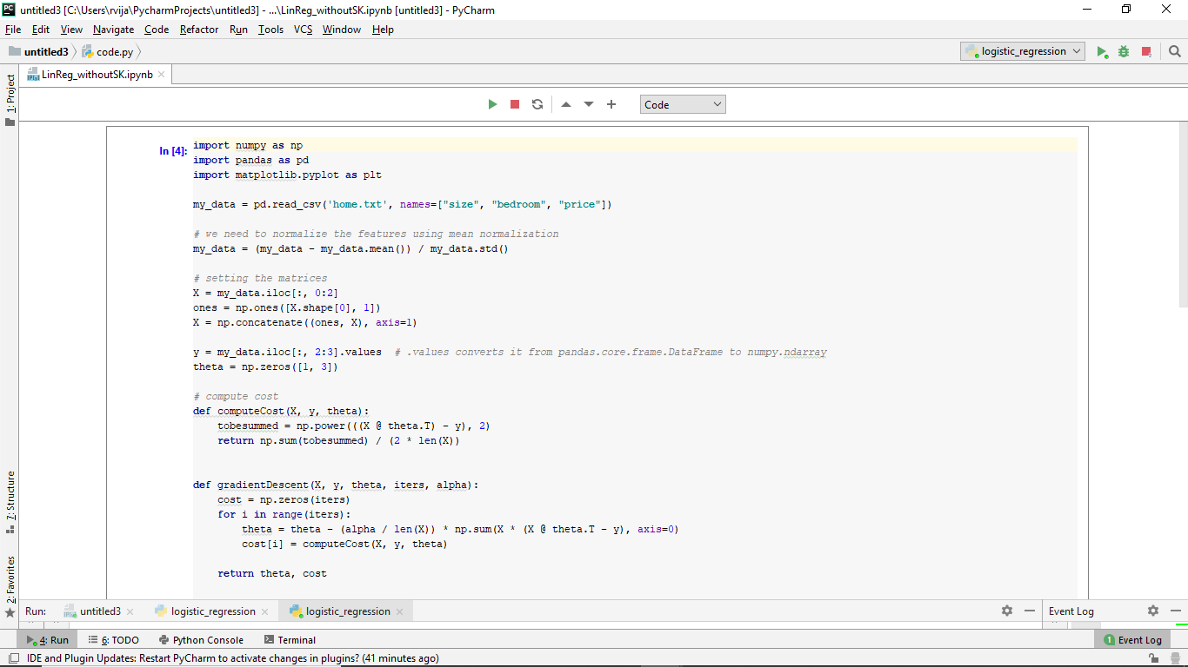
Minor projects

Slide 10
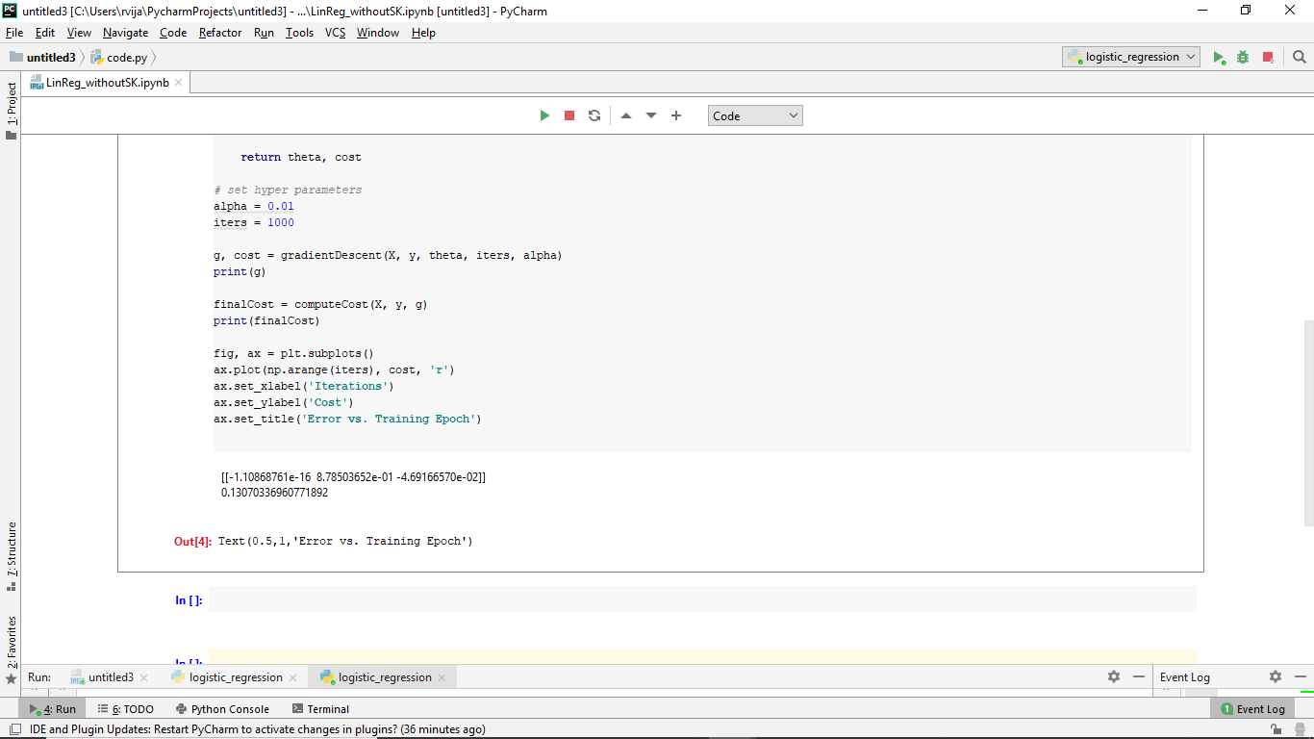

Slide 11
Logistic regression

Slide 12
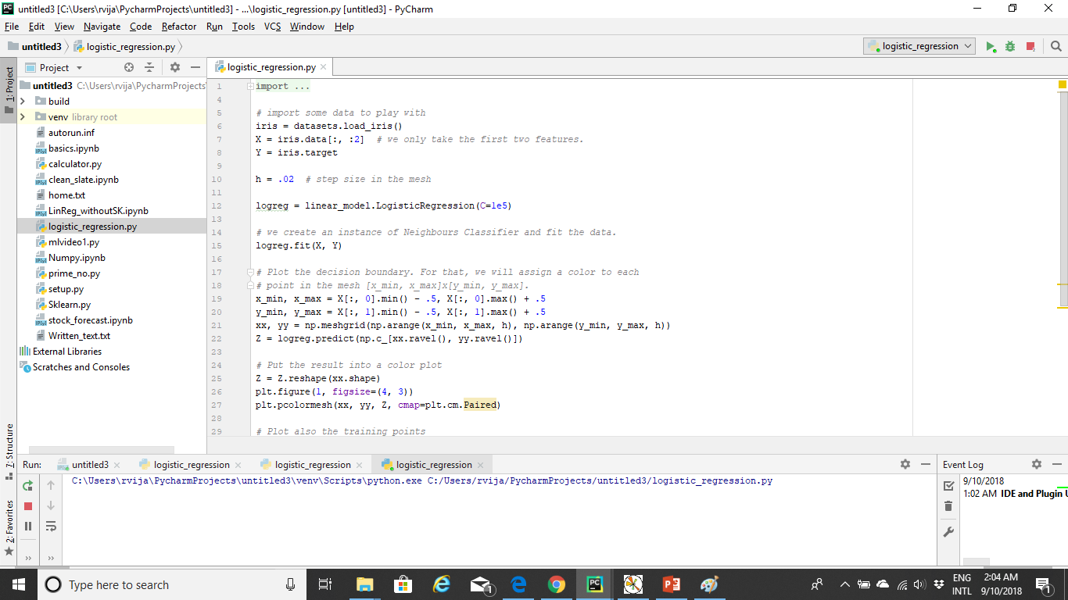

Slide 13
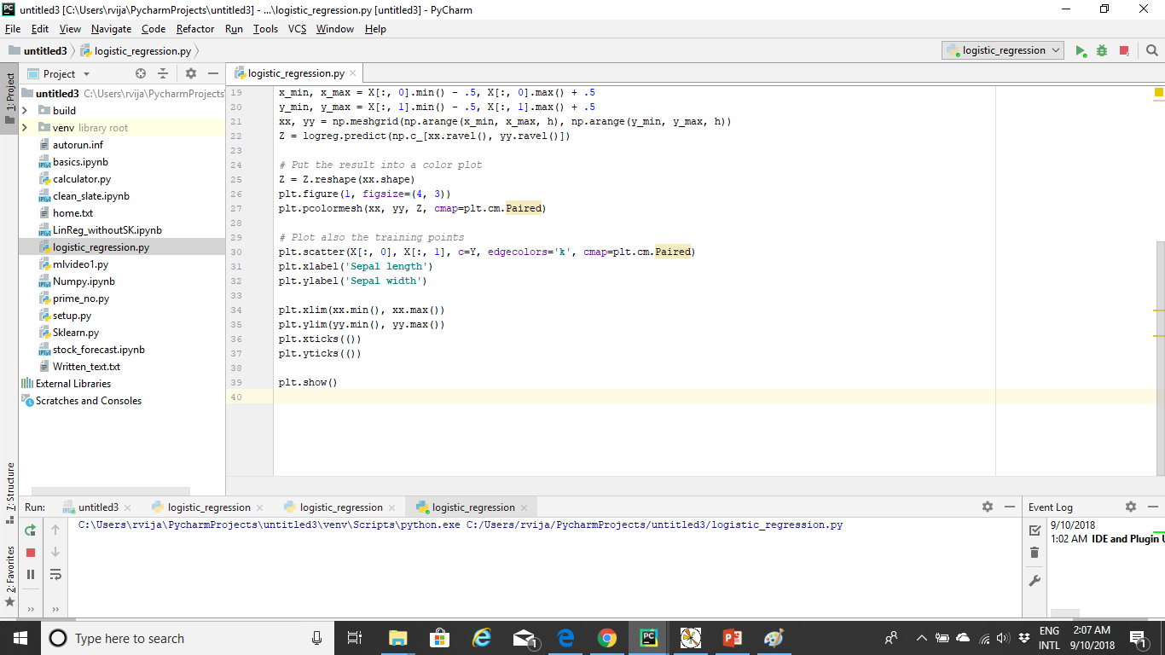

Slide 14
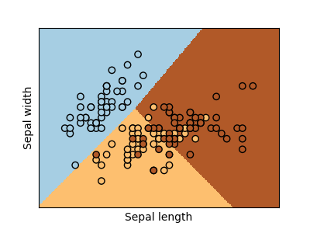

Slide 15
Major project
Implementing Logistic Regression using sklearn through which linear regression has been implemented.

Slide 16
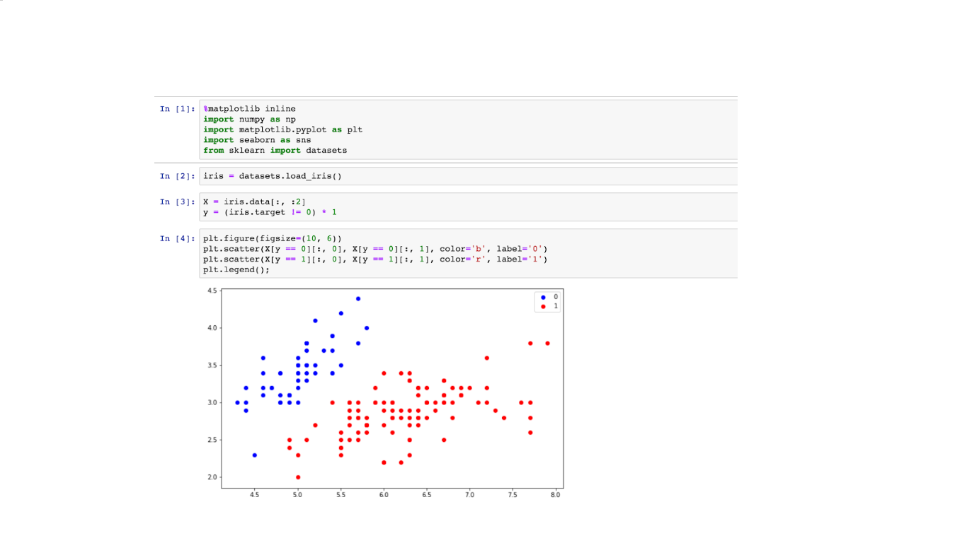

Slide 17
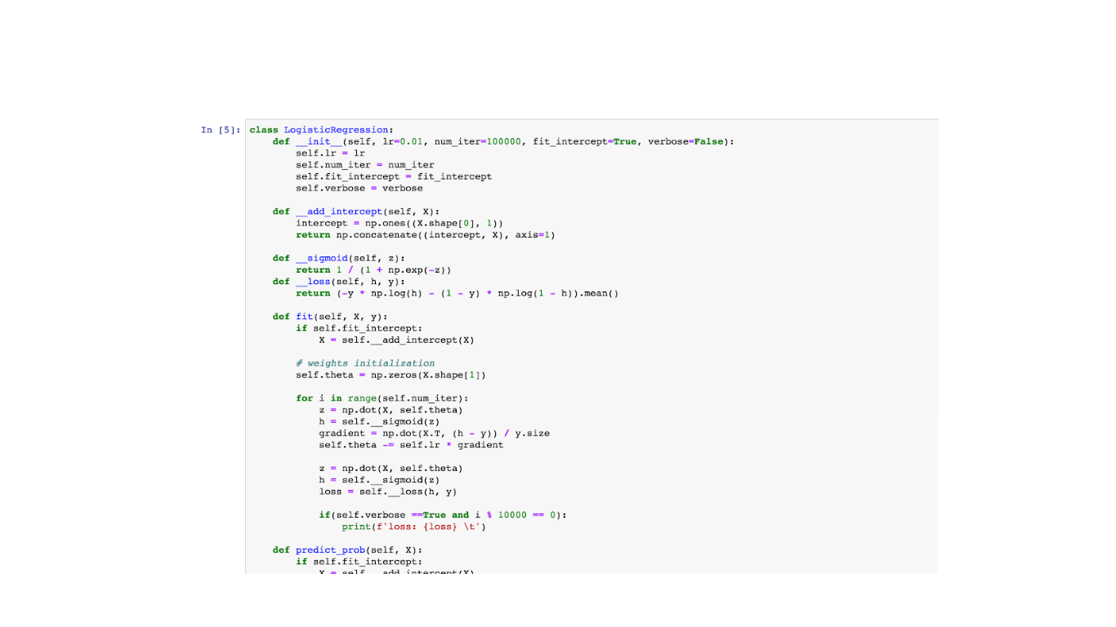

Slide 18
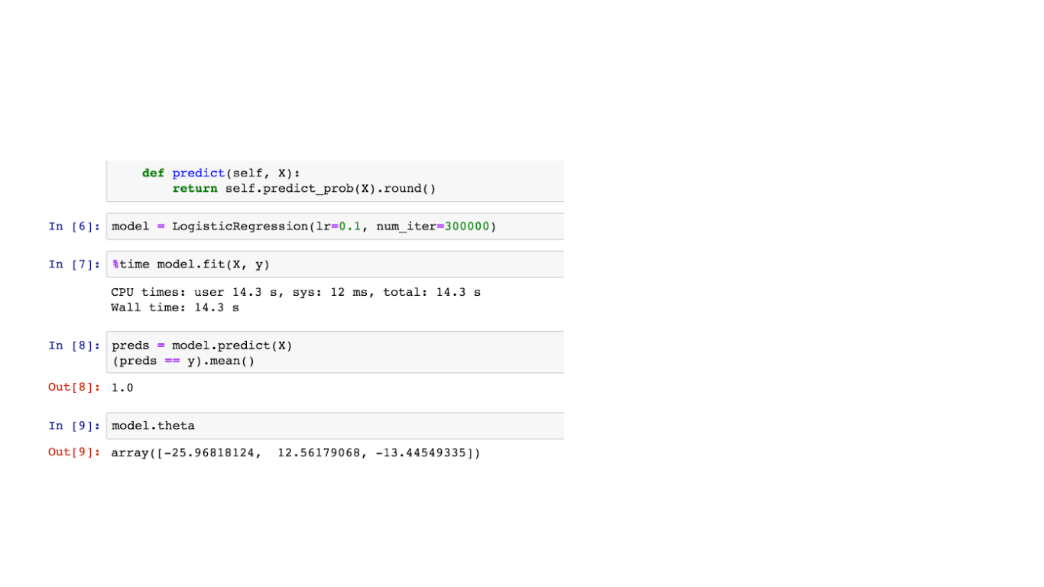

Slide 19
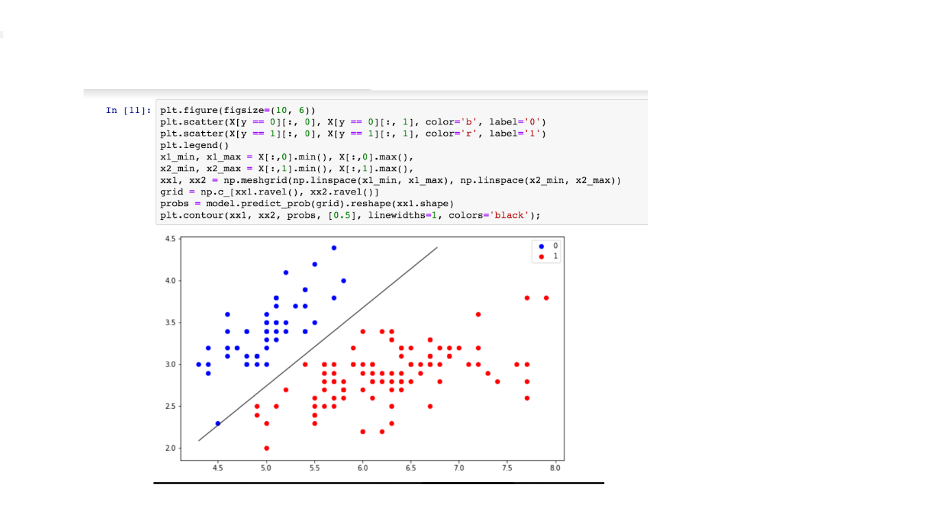

Slide 20
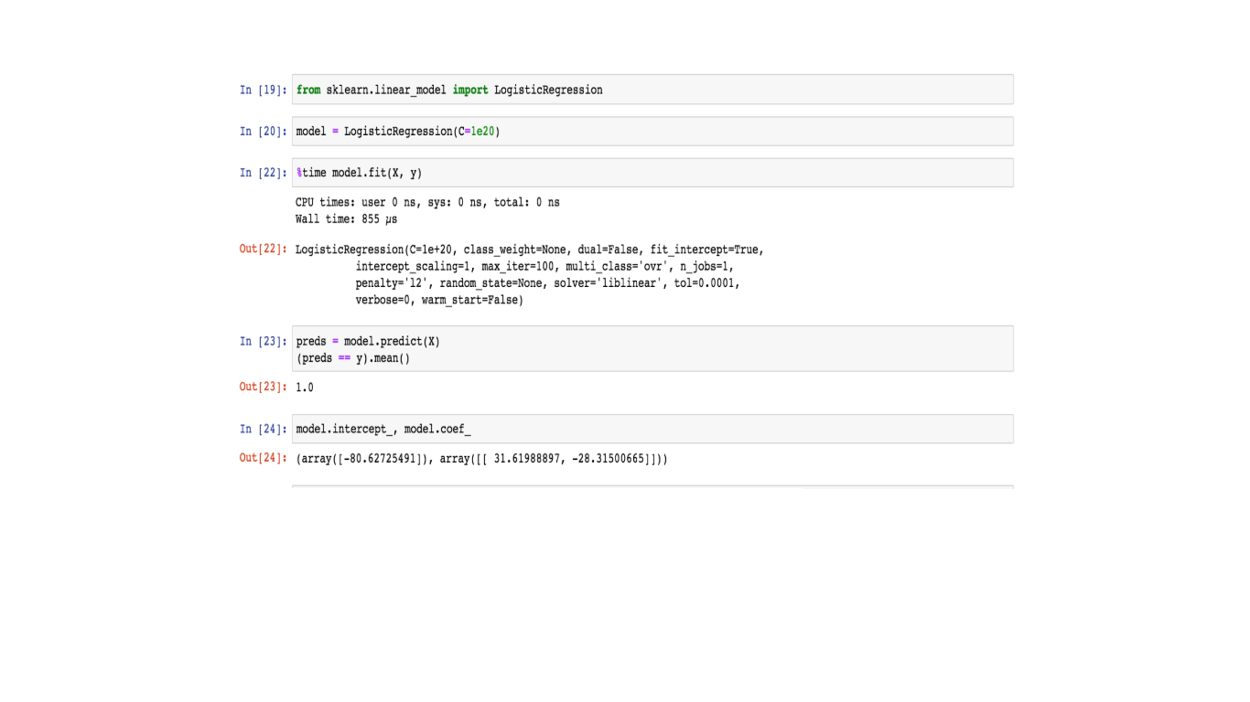

Slide 21
Explanation
The difference between Logistic and Linear Regression is that the function in a Logistic Regression is a sigmoid function where as it is linear in the latter.
A Sigmoid function is where the values are said to be -1, 0 , 1.
This is used to study trends in the job industry.

Slide 22
Explanation of the graph
In the graph above the slope represents the root mean square value. This value denotes the ideal best case situation that can occur while recruiting a viable candidate.
The red and blue dots in the graph represent the values and the scores of the candidates provided by the assessors.
The dots which are closer are the RMSE(Root Mean Square Equation) line is more likely to be recruited in the particular industry.

Slide 23
Tools used
Pycharm
Jupyter Notebook
IDLE
Anaconda Navigator

Slide 24
Libraries used
Sci-Kit
Numpy
Pandas
Matplot

